Slide 1
Check-In Check-Out
Secondary and Tertiary Behavior Intervention
REACH MS
Positive Behavior Interventions and Supports
University of Southern Mississippi
Mississippi Department of Education

Slide 2
REACH MS PBIS Initiative…
Realizing Excellence for ALL Children in Mississippi (REACH MS) is Mississippi’s State Personnel Development Grant which focuses primarily on supporting school-wide and district-wide implementation of Positive Behavioral Intervention and Support (PBIS) at the elementary, middle, and high school levels. Awarded to The Mississippi Department of Education in 2005, the grant is operated by the University of Southern Mississippi’s Department of Curriculum, Instruction and Special Education.

Slide 3
Goals
Review School-Wide PBIS
Define the logic and core features of Targeted Interventions
Provide specifics of the Check-in/Check-out (CICO) approach for Tier 2 interventions
Self-assess if CICO is appropriate for your school
Provide details for modification of CICO for Tier 3 interventions

Slide 4
What is Response to Intervention?
Mississippi’s model for RtI is a comprehensive, problem solving and multi-tiered intervention strategy to enable early identification and intervention for ALL students who may be at academic or behavioral risk.
MDE Response to Intervention Best Practices Handbook (2010)

Slide 5
Mississippi Department of Education
Response to Intervention
Tier 1
  Quality Instruction which describes the school-wide efforts and practices that are available to all students; including:
  Essential Elements
    4) universal screening of behavior
    8) classroom and behavior management
    9) system of behavioral support (school & district level)
MDE Response to Intervention Best Practices Handbook (2010)

Slide 6
Blended Initiatives
Academic Systems
Behavioral Systems
Intensive,
Individual Interventions
Specific students
Intensive,
Individual Interventions
Specific students
1-5%
1- 5%
Targeted Group
Interventions
Targeted students
5-10%
5-10%
Targeted Group Interventions
Targeted students
Universal Interventions
All students
Universal
Interventions
All students
80-90%
80-90%
Dr. George Sugai,
Co-Director Center on PBS

Slide 7
Levels of PBIS
Adapted from Levels and Descriptions of Behavior Support
(George, Harrower, & Knoster, 2003)
School-Wide – Procedures and processes intended for all students, staff, in specific settings and across campus
Classroom – Processes and procedures that reflect school-wide expectations for student behavior coupled with pre-planned strategies applied within classrooms
Target Group – Processes and procedures designed to address behavioral issues of groups of students with similar behavior problems or behaviors that seem to occur for the same reasons (i.e. attention seeking, escape)
Individual Student – Processes and procedures reflect school-wide expectations for student behavior coupled with team-based strategies to address problematic behaviors of individual students
Tier 1
Tier 2
Tier 3

Slide 8
“All specialized interventions are more effective, and more durable, if they are done with school-wide behavioral expectations as a foundation.”
Horner, Sugai, et al. “Check-In Check Out: A Targeted Intervention”
www.pbis.org

Slide 9
School-Wide
Positive Behavior
Support
Tertiary Prevention:
Specialized
Individualized
Systems for Students with High-Risk Behavior
~5%
CICO
Secondary Prevention:
Specialized Group
Systems for Students with At-Risk Behavior
Primary Prevention:
School-/Classroom-
Wide Systems for
All Students,
Staff, & Settings
~15%
~80% of Students
Horner & Sugai, 2007
Notes:
Can’t intervene without universal and secondary!

Slide 10

What is School-Wide Positive Behavior Interventions and Supports
School wide system of support
Proactive strategies
Define, teach and support appropriate student behavior
Create positive school environments

Slide 11

School-Wide PBIS Consists of:
Rules, routines and physical arrangements
that are developed, taught and rewarded
to prevent problem behaviors

Slide 12
School-Wide PBIS focuses on making:
desired behaviors more functional
and
problem behaviors less functional

Slide 13

The goal is to create and maintain a climate in which appropriate
behavior
is the
norm.

Slide 14
PBS involves:
Teaching students how you want them to behave
Reinforcing them when they do behave appropriately

Slide 15
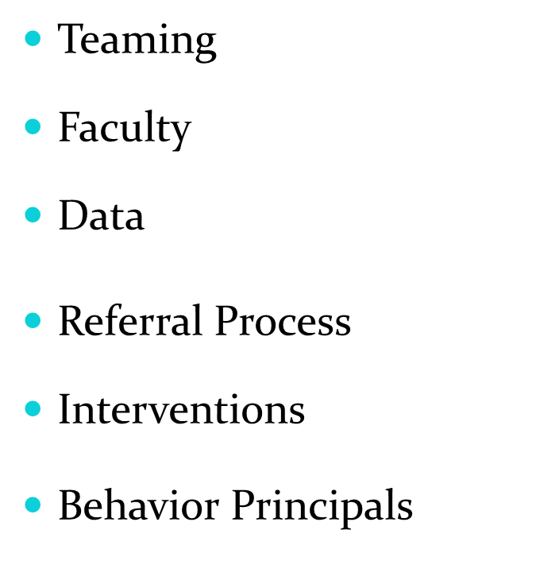
Critical Elements of PBIS
Expectations
Rules
Teaching
Reinforcement System
Using Data to Create Long-Term Change

Slide 16
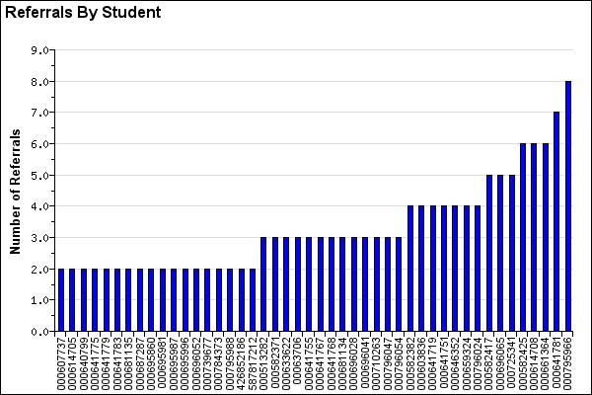
Tier 2 Interventions Target Students with
2-5 ODRs

Slide 17
Major Features of Targeted Interventions
Continuously available
Quickly initiated (72 hr)
Easy for teachers to implement
Consistent with school-wide expectations
All staff/faculty can implement
Can be linked from school to home
Adequate resources (admin, team)
Continuous monitoring for decision-making

Slide 18
Check-In Check-Out (CICO)
Designed to provide support and monitoring for students at-risk of developing serious or chronic behavior problems
Characteristics of students who are good candidates for Check-in/Check-out
  Not responding successfully to School-Wide PBIS system
  Adult attention seeking
  Problem behavior throughout multiple settings
  Mild acting out (not a threat to self or others)
(Horner, Hawken, March )

Slide 19
Components of Check-in Check-out
Goals/expectations are developed and are monitored daily with a point card
    Same expectations for all
    Common schedule
    All staff taught rules for accepting, completing and returning the card.
Instruction on expectations
Daily check-in before school and check-out at end of the day with a positive adult mentor
Regular check-in with teachers during the day to complete point card
Data system to monitor student progress
(Horner, Hawken, March )

Slide 20
CICO Record
Name: ____________________________ Date: ______________
3 = great 2 = good 1 = hard time
Goals | Safe | Responsible | Respectful
Check In | 3 2 1 | 3 2 1 | 3 2 1
Before Recess | 3 2 1 | 3 2 1 | 3 2 1
Before Lunch | 3 2 1 | 3 2 1 | 3 2 1
After Recess | 3 2 1 | 3 2 1 | 3 2 1
Check Out | 3 2 1 | 3 2 1 | 3 2 1
Today’s goal |  | Today’s total points
Notes:
Using your Tier 1 Expectations

Slide 21
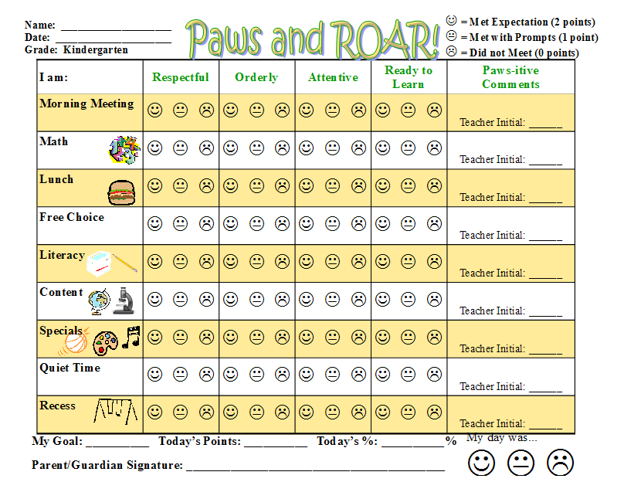
Gale-Bailey Elementary School

Slide 22
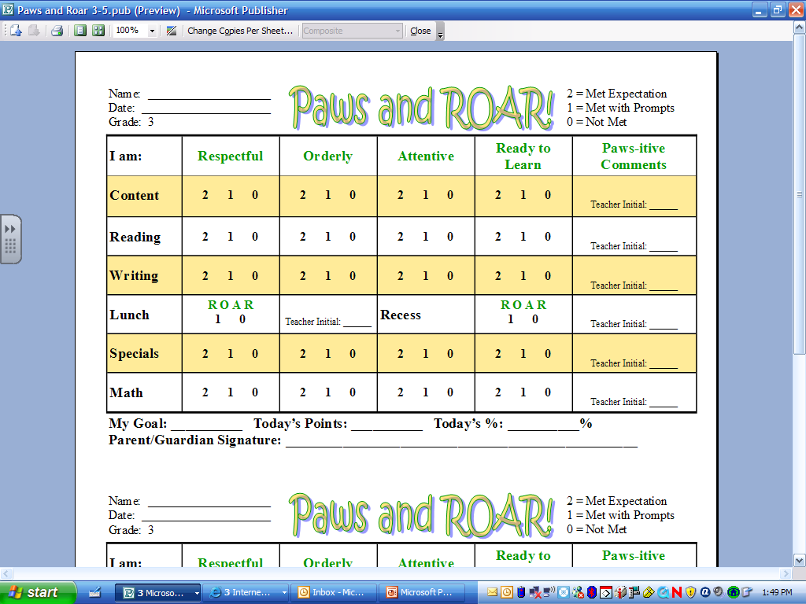
Gale-Bailey Elementary School

Slide 23
Benefits of point card
For staff
  Reminder for specific feedback to student
For student
  Reminder of schedule for day
  Reminder of specific behavioral expectations and goals for the day
  Opportunity to self-recruiting feedback from teachers and parents
  Progress monitoring tool
For school
  Provides data for progress monitoring
  Communication

Slide 24
Check-in Check-out Cycle
CICO Plan
Morning Check-In
Class Check out
Teacher Checks
Home Check-In
Class Check in
Afternoon Check-out
EXIT
(Horner, Hawken, March )

Slide 25
What does it look like?
Morning Check-In
  Location is consistent
  Greet student positively
  Prompt for point card
  Make sure student is prepared for day
    breakfast, planner, pencil, etc.
  Review expectations
http://vimeo.com/19399257
(Horner, Hawken, March )

Slide 26
What Does It Look Like?
Throughout the day
  Criteria is established for points
  Student carries point chart
  Teacher greets and pre-corrects
  Teacher provides feedback and records points
http://vimeo.com/20074101
Positive Feedback
http://vimeo.com/20073355
Corrective Feedback
(Horner, Hawken, March )

Slide 27
What Does It Look Like?
Check-Out
  Location is consistent
  Greets student positively
  Student totals points and determines percentage
  Daily and/or weekly reward given for meeting goals
  Debrief and parent note
  http://vimeo.com/19402368
(Horner, Hawken, March )

Slide 28
So…
The student knows what is expected
Student receives attention throughout the day for meeting these expectations
Parents provide attention for meeting expectations
Self-monitoring skills are developed

Slide 29
Connection to Home
Home report process
  Can be same as point sheet
  Can be a different form
Keeps parent informed of behavior at school
Parents should not reprimand or scold student for unsuccessful day
Parent can provide additional reinforcement at home when child meets daily or weekly goal.

Slide 30
CICO Home Report
Name: _____________________________
Date: _____________
______ I met my goal today ______ I had a hard day
One thing I did really well today was:_______________________
Something I will work on tomorrow is: _______________________
Comments:
Parent/Guardian Signature: ________________________________________________________
Comments:

Slide 31
Why Does CICO Work?
Structure is Improved
Success is Built In
Contingent Feedback is Increased
Intervention can be applied in all school locations
Appropriate behavior is rewarded more frequently
Behavior support and academic support can be linked
Linking school and home support
Program can be modified for self-management
(Horner, Hawken, March )

Slide 32
Is Your School Ready for CICO?
Is School-Wide PBIS in place?
Are problem behaviors a major concern for administration and staff?
Do more than 5 students need extra behavioral support?
      CICO is designed to work with 10-12% of kids in a school
      CICO is typically effective fore 67% of students.
      CICO does NOT replace need for individualized supports.
Are staff willing to commit 5 minutes per day?

Slide 33
Roles and Responsibilities
School team
  Meets at least every 2 weeks
  Identifies students who may be appropriate for CICO
  Monitors implementation
  Modify/fade intervention based on student progress data
Coordinator
  Facilitates morning check-in and afternoon check-out
  Gets point sheets from students and gives new form each morning
  Maintains positive, constructive interactions with the student
  Celebrates successes with the student

Slide 34
Roles & Responsibilities (cont.)
Teachers
  Obtain form from student each day
  Monitor student and completes card according to student behavior
  Provide feedback to student in positive and constructive manner
Students
  Check in and out each day
  Give form to teacher
  Meet expectations
  Take form home and have parents sign, bring to school the next day

Slide 35
Considerations:
Morning Check-In Routine
  Teaching student when, where, how
  Teaching check-in coordinator
    Assess
    Reward
    Set-up for success and Redirect
Teacher Check-in/Check-out Routine
  Teach student when, where, how
  Teach faculty/staff
    Reward
    Set-up for success
    Evaluation

Slide 36
Considerations:
Afternoon Check-Out Routine
  Teaching student when, where, how
  Teach CICO coordinator data collection, acknowledge success, encourage improvement.
  Consider self-recording system for older students
Family Review Routine
  Teach student when, where, how
  Teach family only to acknowledge success, sign

Slide 37
Considerations:
Trading Menu/ Process Menu/ Process
  Reward for collecting and turning in daily progress report information
  Reward for meeting daily goal
  Exchange system for points earned?

Slide 38
What to do with those points?
Peer Attention | Adult Attention | Task Avoidance | Individual Choice
Classroom rewards | Lunch with favorite adult | Time along in activity of choice | Prize from treasure box
Choose partner for an activity | Special time with favorite adult | Get out of class early | Computer time
Sit by friend at lunch | Call to parent | Break, shortened work requirement | Being Leader
Brief free time with friend | Reading with a favorite adult |  | Extra PE or other special
Check out with friend | Help a favorite teacher |  | Free choice of activity

Slide 39
CICO Trading Post
Points Required | Wants attention | Wants item/activity | Wants to escape attention | Wants to avoid something
100 pts | Take note to office/teacher Ask a peer to play/read/draw Be a leader Principals recess | Trip to treasure chest Choose a snack Choose a 5 min. activity School wide sticker Principals recess | Computer time by self | Short break Alternative activity
250 pts | Computer with a friend Extra sharing time | More time for selected activity Free ticket to sporting event | Time alone Independent work space | Alternative assignment
400 pts | Out to lunch with TBA Class recess, free time, or popcorn party | New school /art supplies | Extended time alone | Get out of school early

Slide 40
Additional Considerations:
Planning for Success
  How does a student move off of CICO
  Modifying for self-management
Moving to Individual Behavioral Support
    Functional behavioral assessment
    Comprehensive behavior support
Substitute Teacher use of CICO
  How do you train substitutes?
Utilizing CICO on the playground, cafeteria and bus

Slide 41
Plan for the future: Self-managers
Based on students progress, consider modifying for self-management
  Use natural signals for monitoring as much as possible
  Self-monitor behavior
  Self-record, check for accuracy
  Fewer check points during the day
    Maintain AM and PM times for awhile
  Manage own CICO account

Slide 42
CICO Component of SWIS
School-Wide Information System (SWIS) provides a data collection system for CICO
Allows for progress monitoring of individual students and groups of CICO students

Slide 43
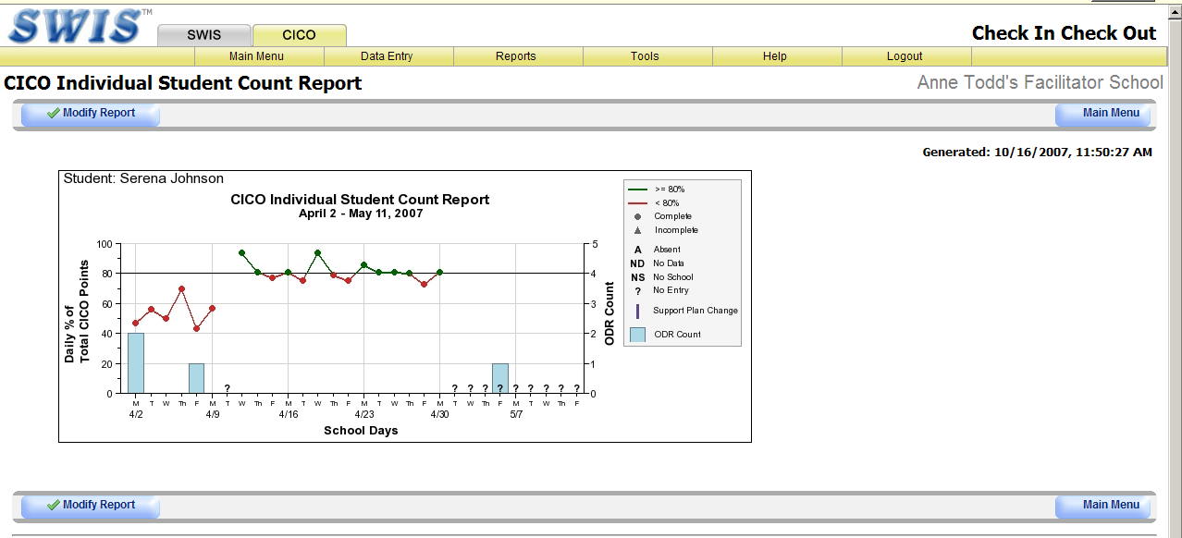

Slide 44
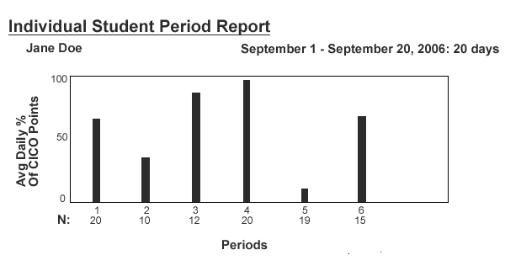

Slide 45
Check-in/ Check-out Self-Assessment
Individually score the elements of the CICO Self-Assessment
    In place; In progress; Not in place
As a team review your ratings, and agree on a single summary for the school
For elements not scored as “in place” define the actions that will move you toward implementation. Who will do what, when?
Define a schedule for meeting to review progress and implement your CICO plan.

Slide 46
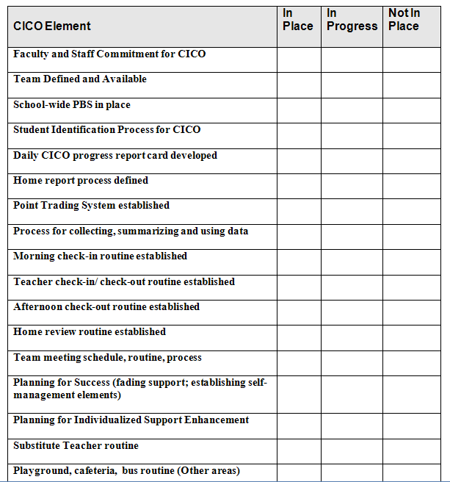
CICO Self- Assessment

Slide 47
Tier 3 Interventions Target Students with
6+ ODRs

Slide 48
CICO Individualized for Tier 3 Interventions
Any CICO program can be modified to meet individual needs of students
  Based on results of Functional Behavior Assessment
  Expectations modified for specific behavioral needs of student
  More frequent checks with mentor
  More frequent individualized reinforcement
  Typically used in combination with skills building (i.e., social skills, anger management, etc.)

Slide 49
CICO Record
Name: ____________________________ Date: ______________
3 = great 2 = good 1 = hard time
Goals | Be Respectful Hands to self | Be Responsible Finish all work | Be Safe Keep chair legs on floor
Check In | 3 2 1 | 3 2 1 | 3 2 1
Before Recess | 3 2 1 | 3 2 1 | 3 2 1
Before Lunch | 3 2 1 | 3 2 1 | 3 2 1
After Recess | 3 2 1 | 3 2 1 | 3 2 1
Check Out | 3 2 1 | 3 2 1 | 3 2 1
Today’s goal |  | Today’s total points
Parent/Guardian Signature: _________________________
Notes:
Using your Tier 1 Expectations

Slide 50
HAWK Report
Date ________ Student _______________Teacher___________________
0 = Not Yet 1= Good 2= Excellent | Be Safe | Be Respectful | Be Your Personal Best |  | Teacher initials
 | Keep hands, feet, and objects to self | Use kind words and actions | Follow directions | Working in class
Class | 0 1 2 | 0 1 2 | 0 1 2 | 0 1 2
Recess | 0 1 2 | 0 1 2 | 0 1 2
Class | 0 1 2 | 0 1 2 | 0 1 2 | 0 1 2
Lunch | 0 1 2 | 0 1 2 | 0 1 2
Class | 0 1 2 | 0 1 2 | 0 1 2 | 0 1 2
Recess | 0 1 2 | 0 1 2 | 0 1 2
Class | 0 1 2 | 0 1 2 | 0 1 2 | 0 1 2
Total Points = Points Possible = 50 |  | Today ______________% |  | Goal ______________%

Slide 51
Adaptations and Variations Todd, A. (2010) Check-in Check-Out: The Intervention
CICO element | Variations/ options | Issues of concerns
1. Check in Check out staff | Educational/instructional assistant School counselor High school mentor | Consistency Efficiency One person or two Freeing up time for person to do the job well
2. Check in/out routine | Come to school early Leave class early Same location/different locations What about tardy students | Missing instruction time How does it work for busers, walkers, car riders?
3. Point system and daily report card | Numbers/words/smiley faces 0, 1, 2 1, 2, 3 great, OK, bad (difficult time) | Age appropriate I get a point for being honest/ trying (1, 2 , 3)
4. Report home | Meet with parents individually as part of the CICO training Provide ideas for comments to write back, things to say to student, how to deal with a bad day Staff mentor signs off if family can’t | Parents might correct kid again Student may forge parent signature
5. Identifying students to participate | Final recommendation by TAT Review of ODRs, teacher concern, family request, student request, administrator request | Avoid reacting to make this a ‘punishment’
6. Staff training | A few at a time (start small to build routine & success) All at once | Efficiency in teaching time Won’t remember unless using CICO What happens when a student gets an office discipline referral?
Notes:
51

Slide 52
Adaptations and variations (continued)
7. Student training | As a group Individually Daily prompts for routine the first five days What to do if staff/teacher isn’t available | Teach students to remind staff/teachers to use program Loss of card during the day
8. Substitute staff | Train a back up check in and check out person Rotate roles so many people can contribute as needed Administrator Front office staff for tardy students CICO cheat sheet for substitute teacher folder | Lack of opportunity to maintain fluency, positive practice, consistency Prevent punitive approach
9. Point trading system | Spending schedule Need a variation of items/activities to fit many situations Discounted school activities work really well Prizes/activities for whole class are great for kids who like peer attention | Too often Not often enough Student absent on spending day Financial costs for rewards Time costs for staff who are ‘earned’
10. Team meeting to review student progress | Weekly data review, call a meeting as needed Email check in with teachers/families | Coordinator not available/ no meeting… no meeting/ no data review…. No data review.. program and/or kid get a bad name if it doesn’t work
Notes:
52

Slide 53
Some Research Articles
  Hawken, L. S. & Horner R. H., (2003) Implementing a Targeted Group Intervention Within a School-Wide System of Behavior Support. Journal of Behavioral Education, 12, 225-240.
  March, R. E. & Horner, R. H. (2002) Feasibility and contributions of functional behavioral assessment in schools. Journal of Emotional and Behavioral Disorders, 10, 158-70.

Slide 54


Resources for Implementing the BEP
Crone, Horner, & Hawken (2004). Responding to Problem Behavior in Schools: The Behavior Education Program. New York, NY: Guilford Press
Hawken, Pettersson, Mootz, & Anderson (2006). The Behavior Education Program: A Check-In, Check-Out Intervention for Students at Risk. New York, NY: Guilford Press

Slide 55
Contact Information:
Sydney Wise
REACH-MS
sydney.wise@usm.edu
www.usm.edu/reachms

